Slide 1
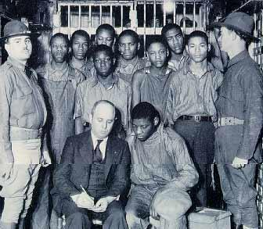
Station 2:
Scottsboro Circumstances

Slide 2
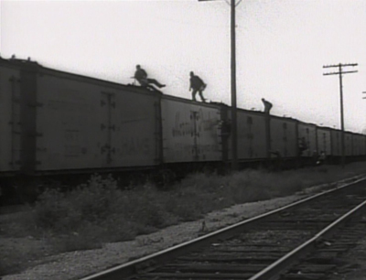
Riding the Rails During the Great Depression
Many teens left their homes or lost their homes and were forced to leave home in search of a better life. They crisscrossed the country illegally riding freight trains looking for work and begging at back doors for food and shelter. This existence was very dangerous for young black men when they traveled through the south.

Slide 3
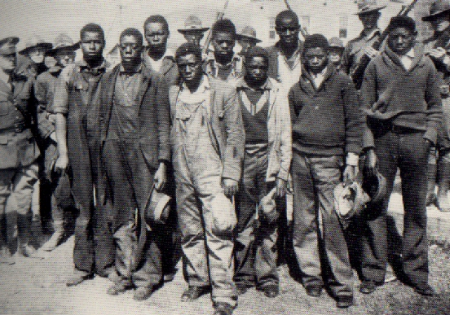
How It All Started
Click Image for Video. Video should START at 2:30; Please STOP video at 7:55.

Slide 4
On the train…
A train had just traveled over the Alabama state line. Some teens were "riding the rails" illegally looking for work, two white women were also traveling on the train.
A fight broke out between some of the Scottsboro boys and several white boys who were riding illegally in the same car. The CAUSE: A white boy stepped on a black boy’s hand.
The white boys lost the fight. After they were thrown off the train they reported a gang attack. At the next stop the black boys were met with a mob who captured them and pulled them off the train.
When the two women were discovered among the illegal travelers, they claimed to have been gang raped by the group of black men. The townspeople almost succeeded in lynching the young boys before police and militia were able to secure the prisons and take them to holding cell in the next town.
Trials for the Scottsboro 9, all of the African Americans rounded up after the fight, began 12 days later.

Slide 5
Station 3
The Doctor's Testimony and Images

Slide 6
Evidence of Rape
Doctor Describes Injuries to Victoria Price and Ruby Bates
Although Mrs. Price insisted that she had fought the Negroes off until her strength gave out, and declared that her head was cut open by a blow from the butt of a pistol wielded by Patterson, Dr. R. R. Bridges, the Scottsboro, physician, who testified just before adjournment, said he had found only superficial bruises and scratches when he examined her. While the doctor was on the stand Judge Horton took a hand in the examination, showing particular interest in the physician's statement that neither Mrs. Price nor her companion, the Bates girl, were hysterical or nervous when they were brought to his office. Not until the next day, he said, did either of them show any signs of nervousness and then, after a night in jail, it manifested itself in tears. The star witness for the State told the sordid details of the crime before a crowded court with unabashed frankness and plain-speaking. She repeated the lewd remarks she said the Negroes made to her without the flutter of an eyelash and in a voice that carried to the furthest corner of the courtroom. The only women in the crowd which heard her story and the very clinical medical testimony which followed it were two visitors from New York. At times they looked as though they wished they had not come. There was little that was new in the testimony Mrs. Price gave under direct examination by Mr. Knight. She and the Bates girl, a mill worker like herself, decided, she said, to go to Chattanooga in search of employment. Wearing overalls over three dresses they wore to avoid carrying hand luggage, she said, they hopped a freight train and arrived in Chattanooga on the evening of March 24, 1931.

Slide 7
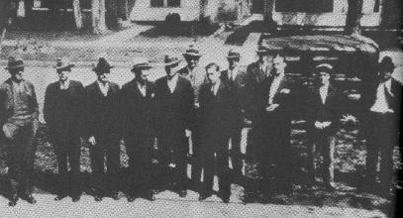
The all white/all male jury for one of the trials.

Slide 8
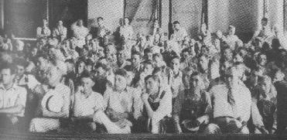
Spectators in the court room…what do you notice?

Slide 9
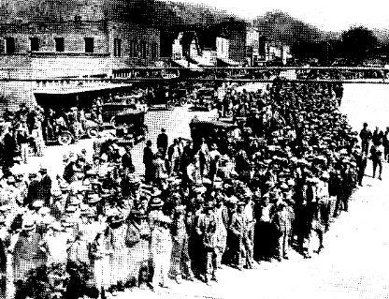
People line up for one of the many trials.
Notes:
*

Slide 10
Station 4
The Accusers Take the Stand: Victoria Price and Ruby Bates

Slide 11
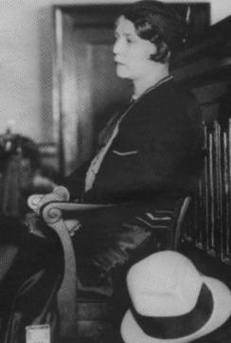
Victoria Price
Lower class white woman, age 21
An active prostitute who liked to drink; daughter of a widow who lived in a racially mixed section of town, worked at the mill, seen having intercourse in public places
Good on the stand, hostile, but made graphic allusion to the events that she claimed occurred.

Slide 12
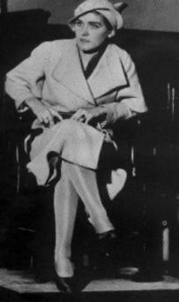
Ruby Bates
Lower class girl, familial problems, was said to have “played, lived and slept with blacks.”
Described as a very active prostitute
Poor witness on the stand

Slide 13
In Their Own Words: Quotes from the Trial
"There were six to me and three to her....It took three of them to hold me. One was holding my legs and the other had a knife to my throat while the other one ravished me." --Victoria Price (Carter, 58)
"He said... you will have a negro baby."
--Victoria Price quoting her alleged attacker (Alabama v Patterson, Record)
"I saw all of them have intercourse; I saw all that with my own eyes." --Scottsboro boy Roy Wright, age 13, testifying in the first trial
"We all have a passion, all the men in this courtroom, and that is to protect the womanhood of the state of Alabama." -- Prosecutor Knight addressing the jury in the third Patterson trial, Nov. 30, 1933

Slide 14
Accusers and the Accused
White Women
Black Men
Victoria Price
Ruby Bates
Haywood Patterson
Charles Weems
Clarence Norris
Andy Wright
Ozzie Powell
Olen Montgomery
Eugene Williams
Willie Roberson
Roy Wright, age 12

Slide 15
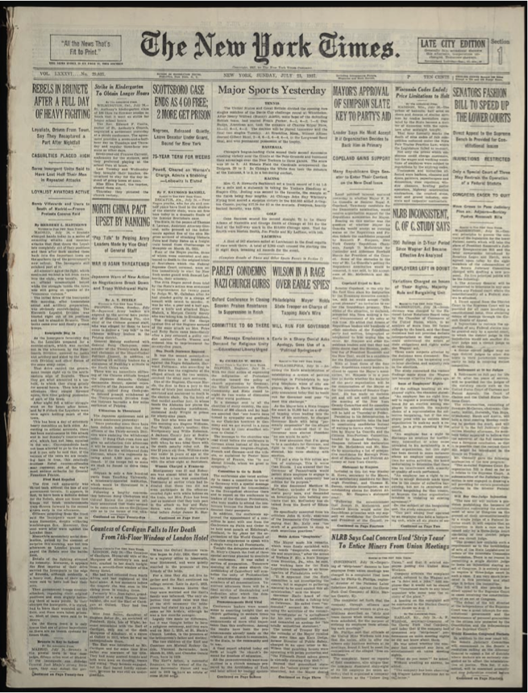
Station 5: Newspaper Articles

Slide 16
Click for Southern Newspaper Article

Slide 17
Northern Newspaper Article
ARTICLES FROM THE NEW YORK TIMES
March 25, 1931
JAIL HEAD ASKS TROOPS AS MOB SEEKS NEGROES
Riot Feared in Scottsboro Ala., After Arrest of Nine, Held for Attacking Girls
Special to The New York Times
HUNTSVILLE, Ala., March 25
Fearing a mob outbreak at Scottsboro, county seat of Jackson County, following the arrest of nine Negroes charged with attacking two white girls, a detachment of militia was ordered to the Jackson County jail tonight.
Sheriff Waun at Scottsboro asked for troops when a crowd which had gathered about the jail became threatening. The Sheriff wired to Montgomery that the crowd numbered 300.
Later, however, the sheriff reported that the mob wa dispersing as the night was cold, and danger seemed averted.
The girls, who gave their names as Ruby Bates, 21, and Victoria Price, 18, were in a box car with seven white men when the Negro tramps got in at a point between Stevenson and Scottsboro. They threw six of the white men off the train.
The seventh and the girls are said to have fought desperately until the white man was knocked unconscious.
The men who had been thrown out of the car telegraphed ahead to Paint Rock. When the train arrived there a Sheriff's posse surrounded the car and captured the Negroes after a short fight.
The Negro prisoners and their white accusers were taken to Scottsboro where the Negroes were formally charged with criminal assault on a woman, a capital offense in Alabama. The white men who had been in the box car were held as material witnesses.

Slide 18
Works Cited
www.law.umkc.edu/faculty/projects/FTrials/scottsboro/SB_acct.html
http://www.law.umkc.edu/faculty/projects/FTrials/scottsboro/scottsb.htm

