Slide 1
Themes
To Kill a Mockingbird

Slide 2
Theme:
The central idea of a literary work.
Ideas explored by a literary work.
TheMessage the author is trying to bestow upon readers.

Slide 3
You Decide.
Look and Listen:
Based on the lyrics of the following songs, what theme do they have in common?
Use your graphic organizer to take notes, highlight lyrics that support your ideas and explain your thoughts.

Slide 4
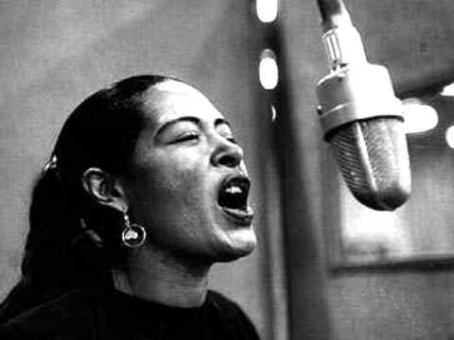
Strange Fruit by Billie Holiday
Southern trees bear strange fruit
Blood on the leaves and blood at the root
Black bodies swinging in the southern breeze
Strange fruit hanging from the poplar trees
Pastoral scene of the gallant south
The bulging eyes and the twisted mouth
Scent of magnolias, sweet and fresh
Then the sudden smell of burning flesh
Here is fruit for the crows to pluck
For the rain to gather, for the wind to suck
For the sun to rot, for the trees to drop
Here is a strange and bitter crop

Slide 5
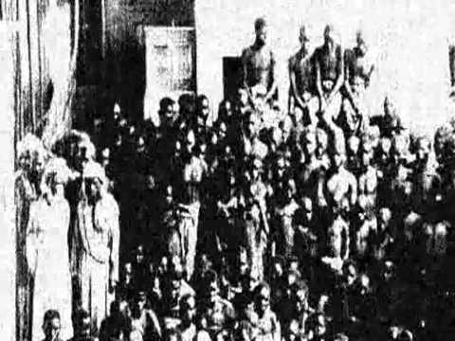
Jena by John Mellencamp
An all white jury hides the executioner's face
See how we are, me and you?
Everyone here needs to know their place
Let's keep this blackbird hidden in the flue
Oh oh oh Jena
Oh oh oh Jena
Oh oh oh Jena
Take your nooses down
So what becomes of boys that cannot think straight
Particularly those with paper bag skin
Yes sir, no sir, we'll wipe that smile right off your face
We've got our rules here and you must fit in
Some day some way sanity will prevail
But who knows when that day might come
A shot in the dark, well it just might find its way
To the hearts of those that hold the keys to kingdom come

Slide 6
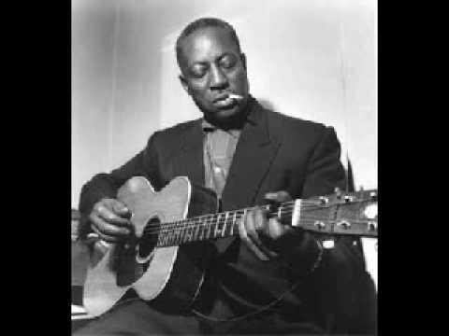
I Wonder When I Will Be Called a Man
by Big Bill Broonzy
When I was born into this world, this is what happened to me
I was never called a man, and now I'm fifty-three
I wonder when will I get to be called a man
Do I have to wait till I get ninety-three?
When Uncle Sam called me, I knowed I'd be called a real McCoy
But I got none of this, they just called me soldier boy
I wonder when will I get to be called a man
Do I have to wait till I get ninety-three?
When I got back from overseas, that night we had a ball
Next day I met the old boss, he said "Boy get you some overalls"
I wonder when will I get to be called a man
Do I have to wait till I get ninety-three?
I've worked on the levee camps, and axer gangs too
Black man's a boy, don't care what he can do
I wonder when will I get to be called a man
Do I have to wait till I get ninety-three?
They said I was uneducated, my clothes were dirty and torn
Now I've got a little education, but I'm still a boy right on
I wonder when will I get to be called a man
Do I have to wait till I get ninety-three?

Slide 7
Theme? You Decide...
What theme do these songs have in common?
How do you know? Pull a line from each song to support yourself.
Take 10 minutes to complete the graphic organizer.
Be specific, this could help you prep for another assignment… just sayin.

